Slide 1


Slide 2
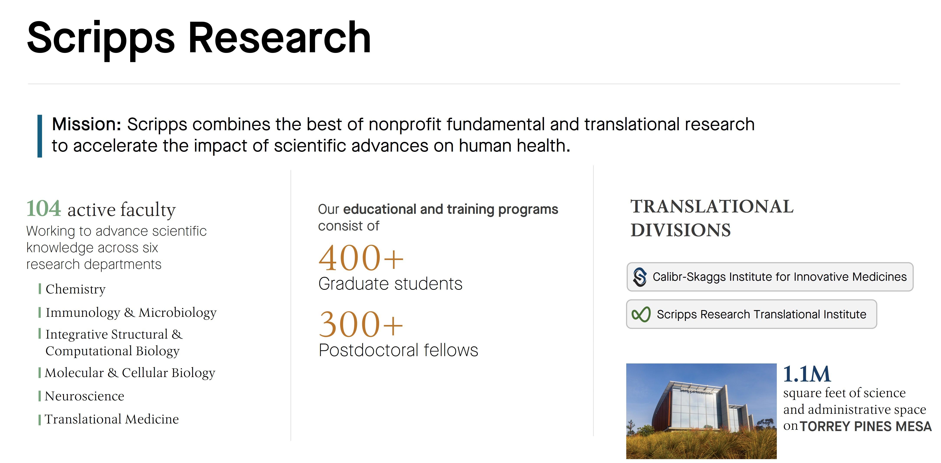

Slide 3
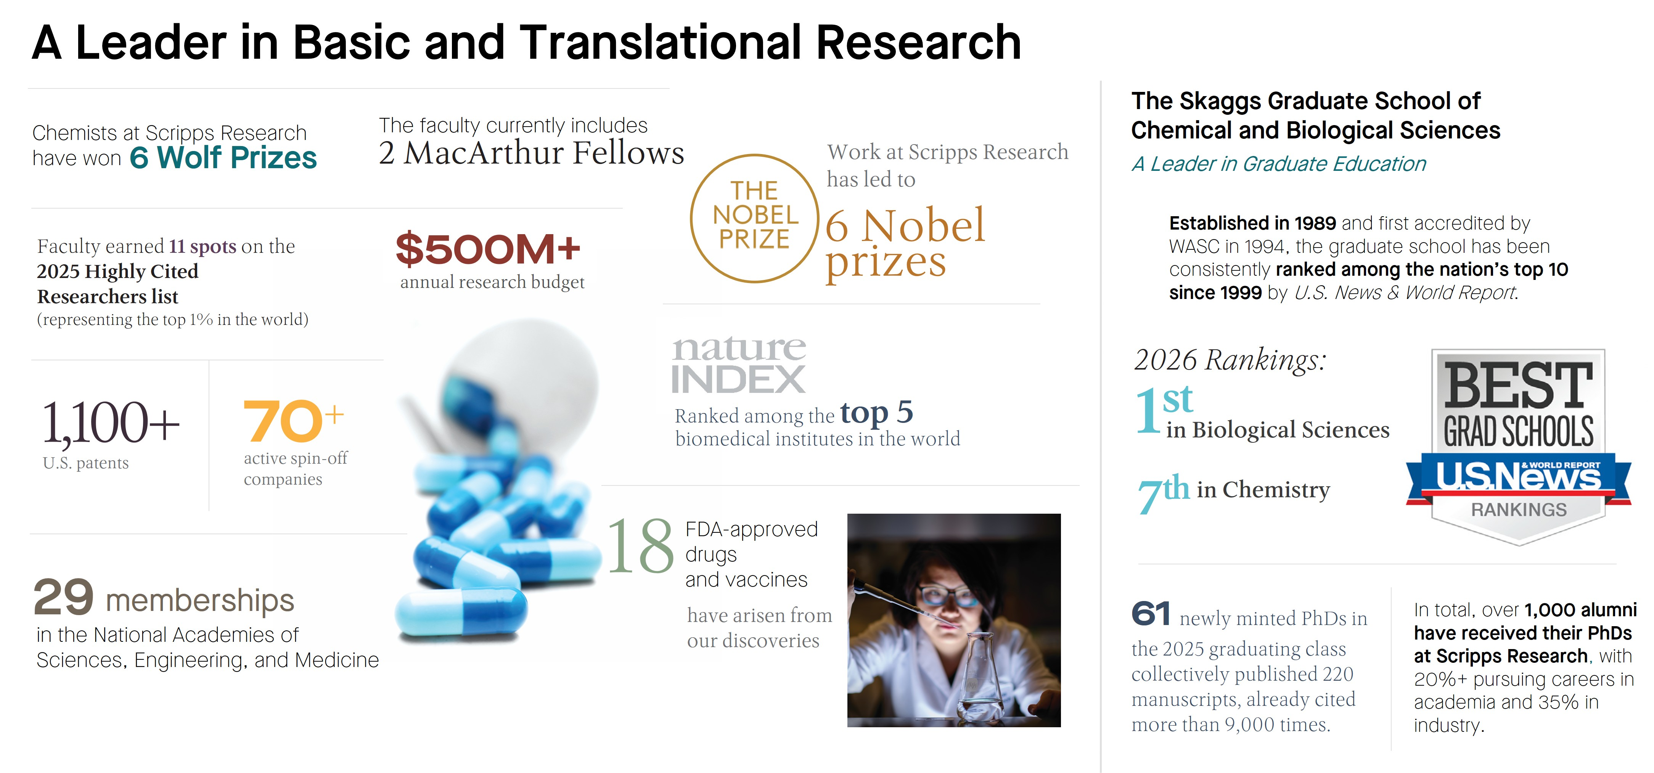

Slide 4
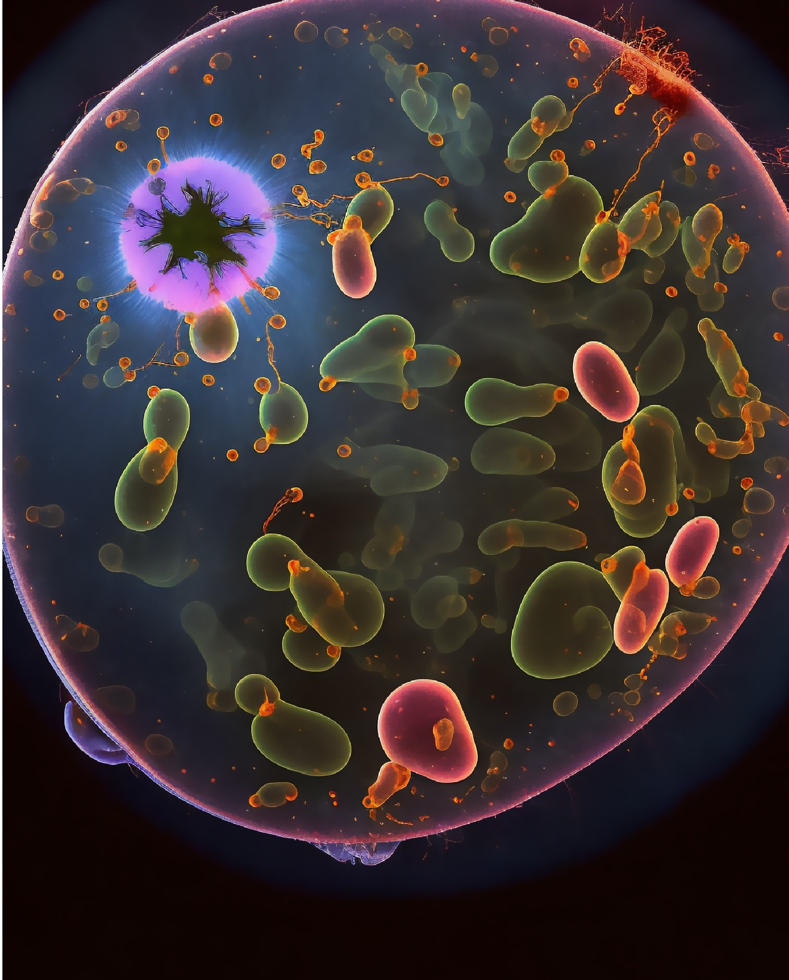
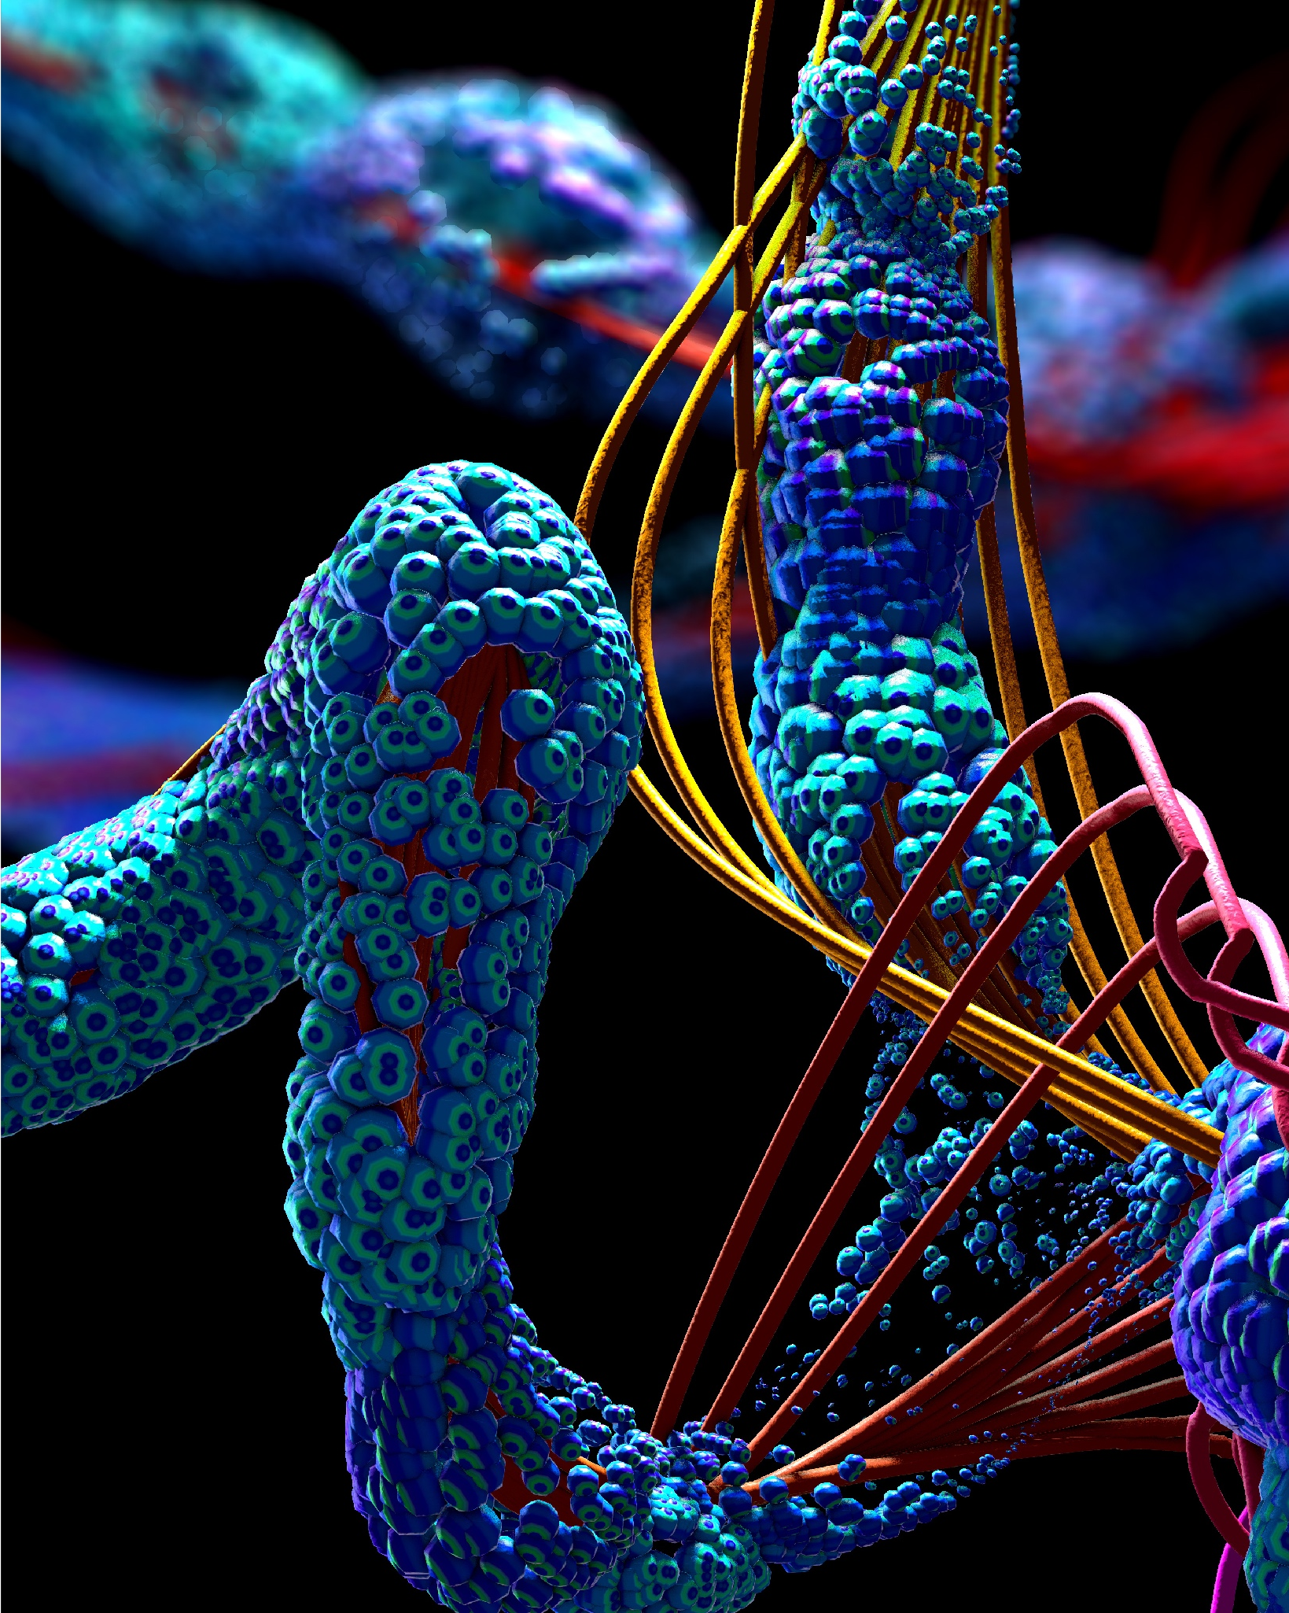
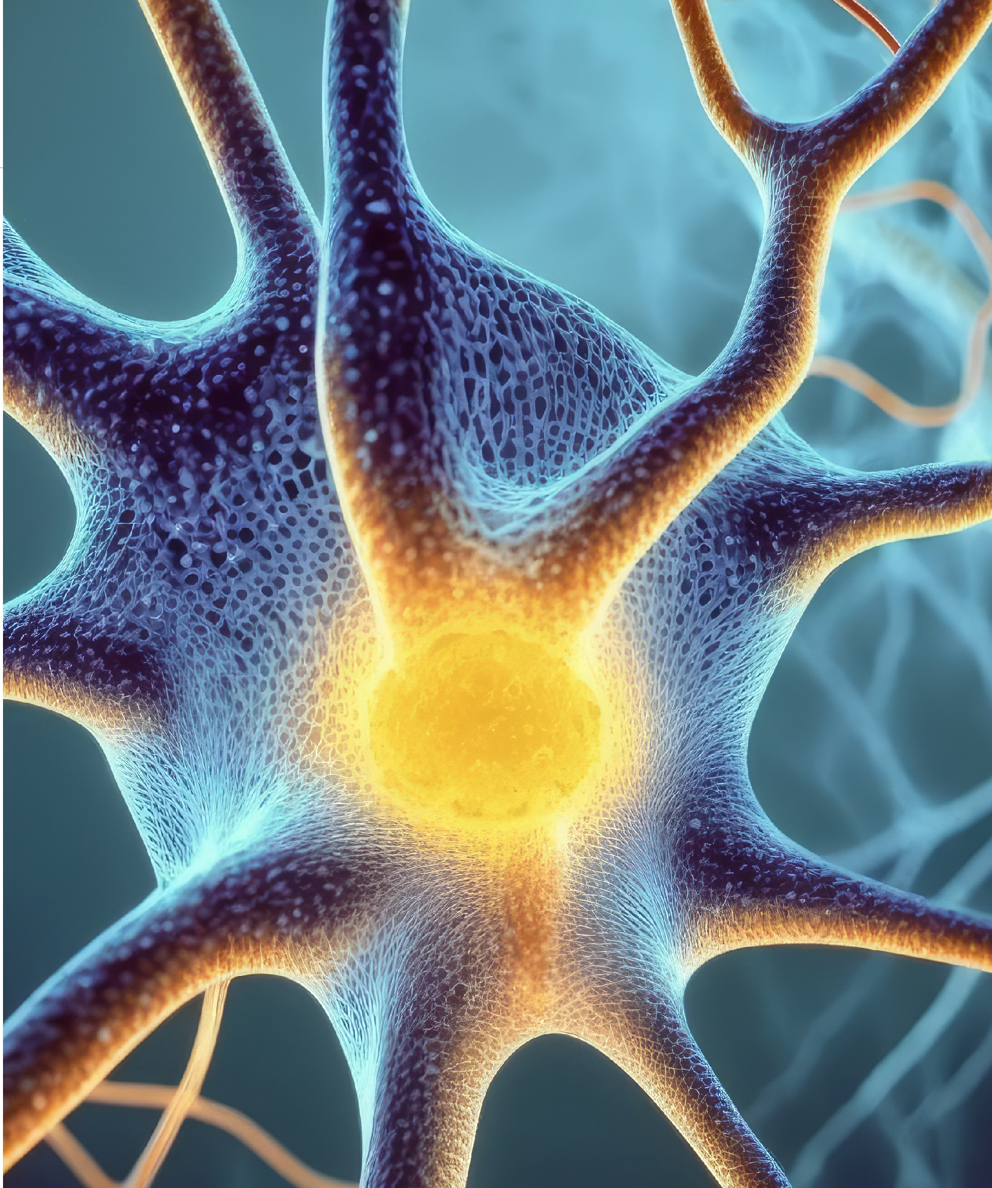
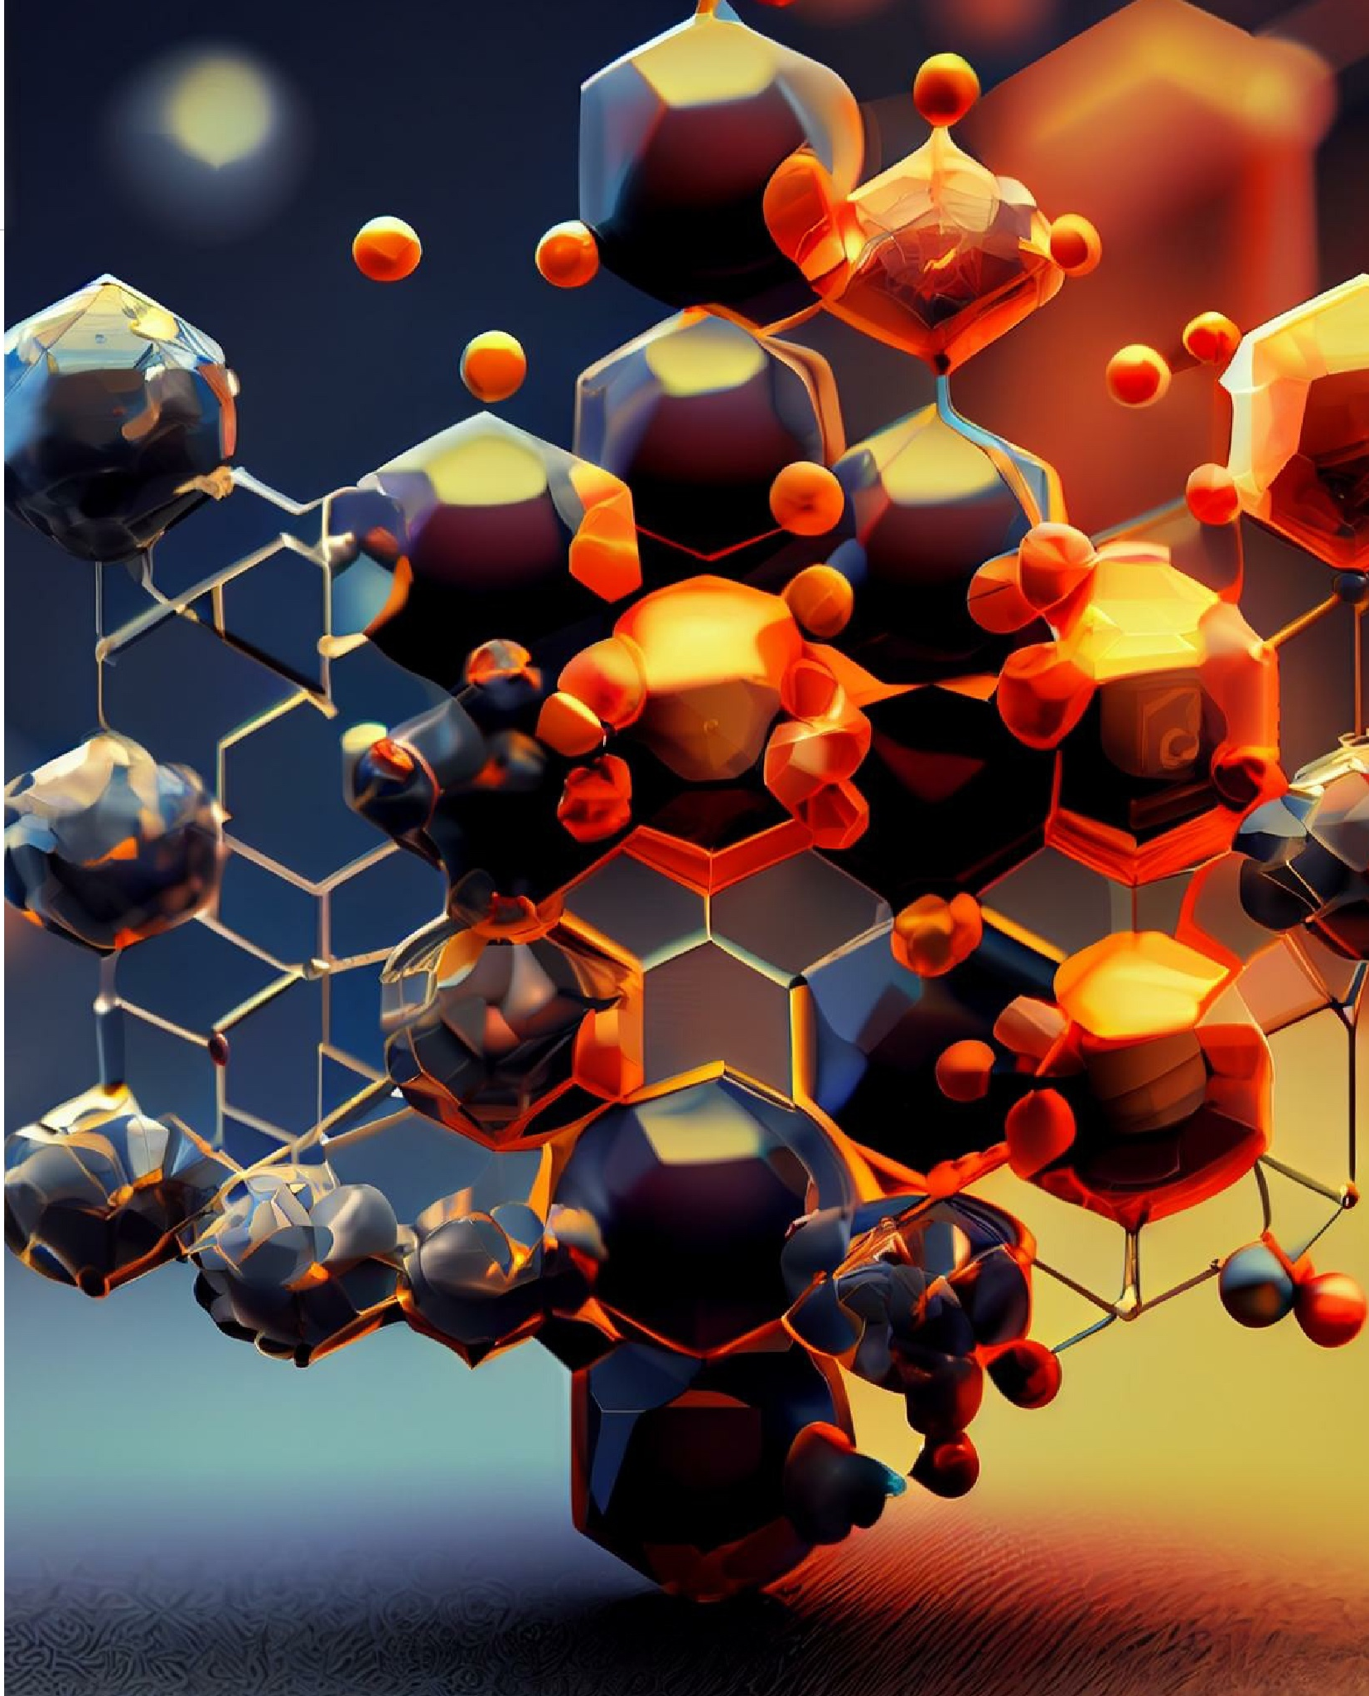
A Sampling of Scientific, Medical and Technological Advances
Understanding the sense of touch
Understanding the structural basis of T cell recognition
Deconvoluting the structural basis for GPCR signaling by GLP1
Developing powerful asymmetric synthesis and C-H activation methods
Expanding the genetic code of living organisms with new building blocks
New methods to synthesize complex carbohydrates and glycoproteins
The discovery of innate immunity
Developing new medicines including tafamidis, ozanimod and Surfaxin®
Combinatorial antibody and chemical libraries and screening methods to accelerate drug discovery
The structure of the Covid spike protein that enabled vaccine development
Proteomics and structural genomics tools to identify new protein targets for cancer
New methods for the design of more effective vaccines

Slide 5
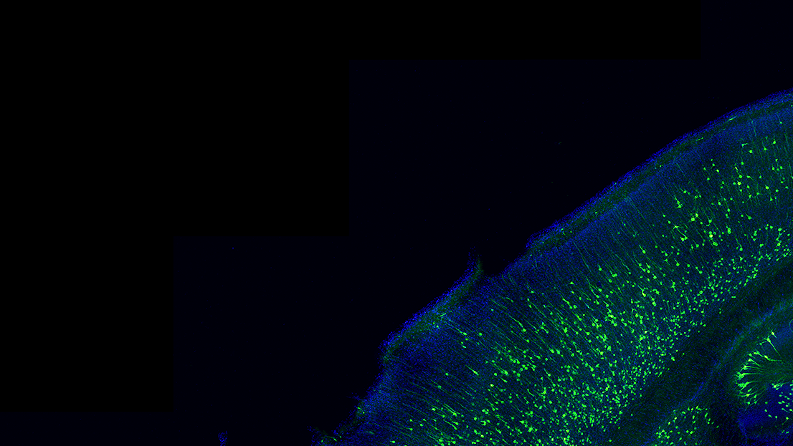
Some New Initiatives
Aging, AI and Global Health

Slide 6
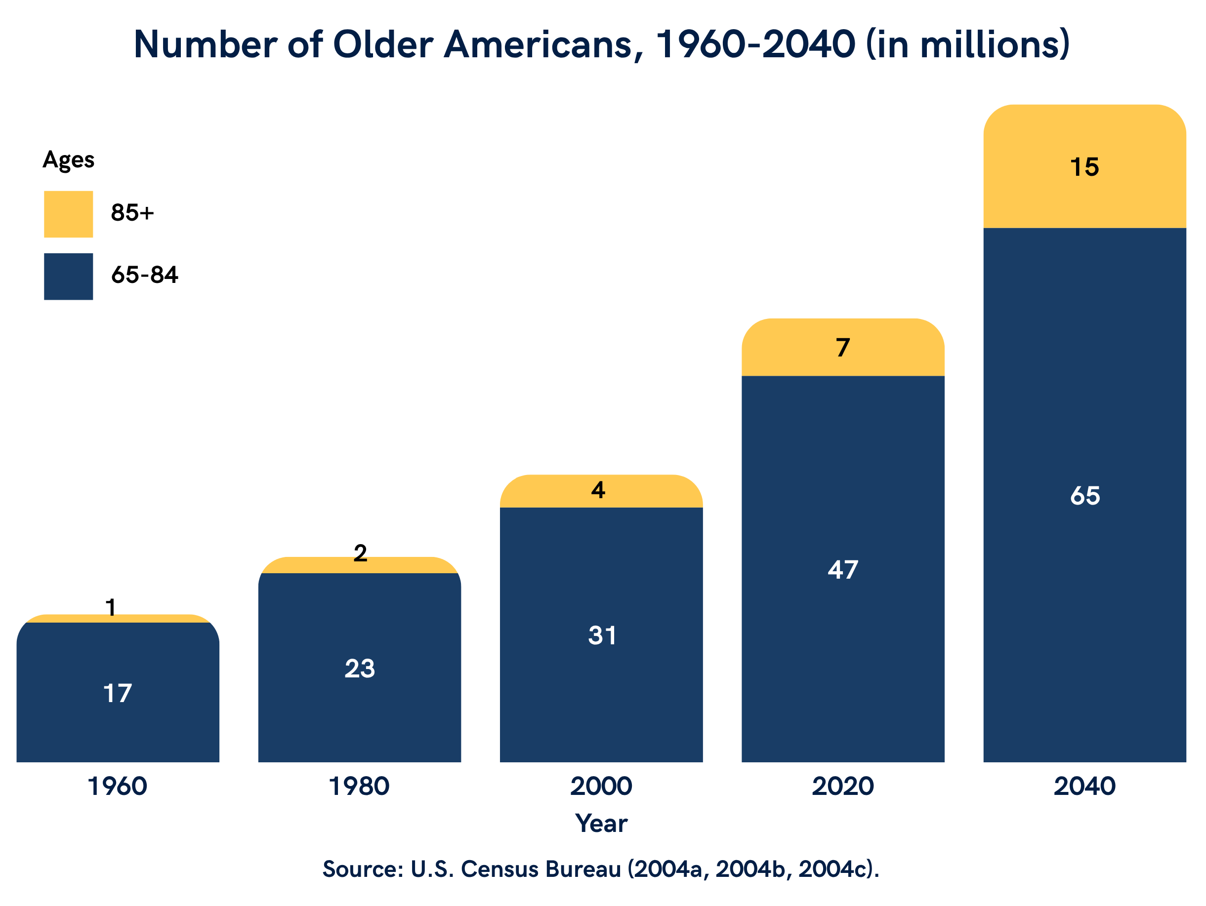
Healthy Aging | Facing an Aging Population
The Problem
In the U.S. alone, the 65 and older population will surge to 80M people by 2040
~93% of older adults have at least one chronic condition, and 80% have two or more, including heart disease, cancer, diabetes, dementia, arthritis and chronic pain which significantly impact quality of life
Multiple chronic conditions among older adults cost the U.S. healthcare system over $1 trillion annually
Therapeutics to target age-related chronic diseases and extend healthy lifespan could improve the quality of life for millions of individuals while saving hundreds of billions of dollars
Our Approach
Scripps Research scientists have made major advances in deciphering the biological underpinnings of aging and disease risk
Scripps Research has the translational capabilities to create a new generation of medicines and preventive strategies to address chronic age-related diseases

Slide 7
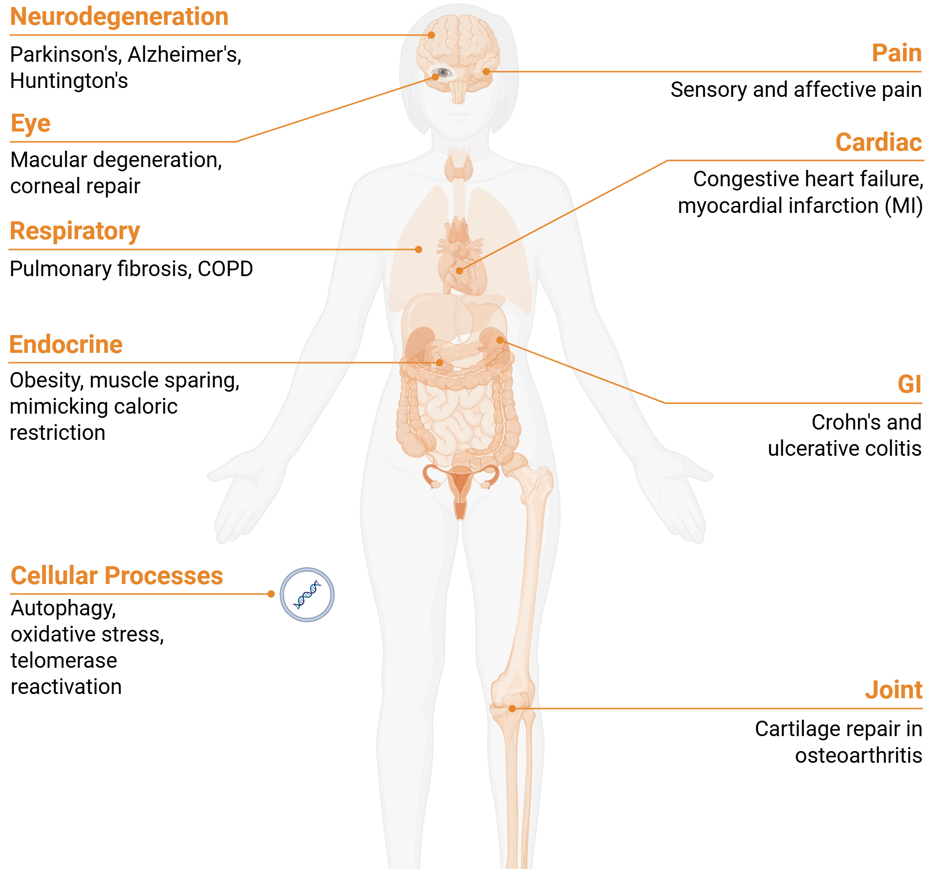
Aging | Targeting the Causes and Consequences of Aging
Regenerative Medicine
Longevity
Reversing the Damage of Age-related Disease
Most approaches only slow disease progression but do not reverse damage
Modulating the fate of endogenous stem cells with drugs to repair tissue damage and reverse disease progression
Regenerative medicine programs ongoing to repair the joint, retina, heart, lungs, and GI; all are major age-related diseases
Increasing Lifespan and Healthspan
Deciphering biological mechanisms that might be leveraged to safely extend lifespan
Targeting nutrient-sensing mechanisms as well as activating pathways for maintaining and protecting healthy tissues and metabolic balance
Healthspan
Improving the Quality of Life As We Age
Advancing research on the neurological mechanisms underlying pain to create new, nonaddictive targeted treatments foir pain
Addressing obesity and its related morbidities
New cancer therapies
Protecting organs from oxidative stress and inflammation (stroke, heart and neurodegenerative disease)
Digital medicine and AI to better understand those factors that affect healthspan

Slide 8

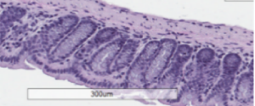
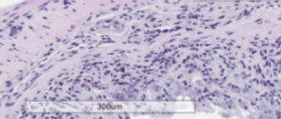
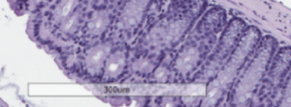
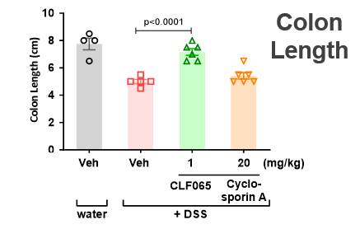
Aging: Regeneration | Reversing the Damage of Disease
Engineered therapeutic peptide regenerates mucosal barrier in intestinal disease
Background
CLF065: GLP2 peptide engineered with fatty acid staple
Regenerative approach to gut barrier repair in chronic intestinal diseases leverages the intestinotrophic, anti-inflammatory, and anti-apoptotic effects of the GLP2R pathway to promote endoscopic healing and long-term remission, complementing current anti-inflammatory therapies
Lead indication: inflammatory bowel diseases (IBD) such as Crohn’s with potential to treat other conditions such as chronic pouchitis, ulcerative colitis, and others
CLF065 Improves Colon Histopathology
in a DSS-induced Colitis Model
Approach
Calibr-Skaggs’ novel fatty-acid peptide stapling platform technology used to generate CLF065
Robust intestinal regeneration with histologic recovery and reduced inflammation across acute and chronic colitis rodent models
Well-tolerated with long half-life and excellent potency (0.2 nM)
water: Vehicle
+DSS: Vehicle
Status
Phase 1 Clinical Trial
IND May 2022, completed trial [106 subjects] in 2023:
~140 hr best-in-class human half-life, significant dose-dependent increase in biomarker
Well-tolerated with no treatment-related serious adverse events reported
+DSS: CLF065
Phase 2 Clinical Trial
Phase 2 trial in J-pouch surgery-induced chronic pouchitis ongoing (OPUS trial)
2027 Phase 2 RCT in Crohn's disease to be initiated
DSS=dextran sodium sulfate; Veh=vehicle

Slide 9
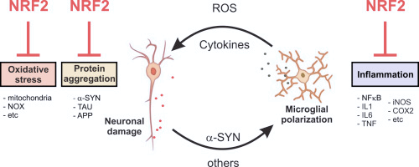
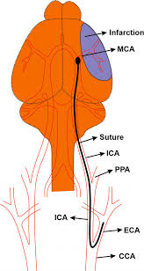
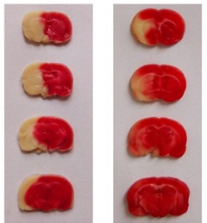
Aging: Prevention | Activating Natural Protective Mechanisms for Neurodegenerative Disease and Stroke
Preventing tissue damage by activating the NRF2 transcriptional program in the brain
NRF2 activation targets multiple aspects of
Parkinson’s Disease etiology
Rationale
NRF2 serves as a master regulator of oxidative stress response, promoting tissue protection and decreasing tissue damage in response to stressors in multiple organs
Reactive oxygen is a major contributor to brain damage in Alzheimer’s, Parkinson’s and stroke
A selective, brain-targeted NRF2 activator with good safety has potential to be broadly protective in the brain for damage driven by oxidative stress including stroke, Alzheimer’s and Parkinson’s disease
Approach
Approved NRF2 activator Omaveloxolone (Friedrich’s Ataxia) lacks brain penetrance
Identified novel compound series, exploiting an endogenous metabolite signaling system for selective NRF2 activation
NRF2 activation reduces brain damage after stroke
Middle cerebral artery occlusion
(MCAO) stroke model
MCAO
+ NRF2
activation
MCAO
+ vehicle
Status
Infarct blocks (red) blood oxygen, resulting in
and (white) tissue death
Activation of NRF2 pathway reduces (white) tissue death
Extensive medicinal chemistry campaign identified brain-penetrant NRF2 activators with excellent activity
Compound series efficacious in intestinal and CNS disease models with good safety
Initiate IND-enabling studies

Slide 10
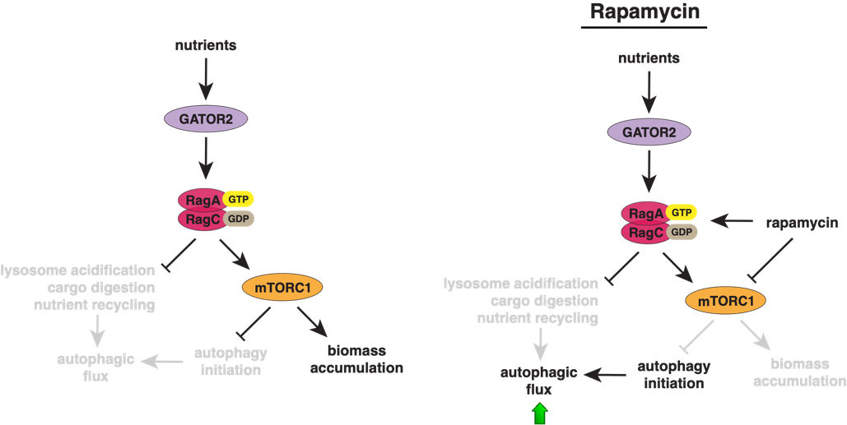
Aging: Longevity | Selective mTORC1 Pathway Inhibition to Expand Lifespan
Caloric restriction (CR) is the most well-validated way of extending lifespan in animals & health biomarkers in humans
Rationale
Targeting mTORC1 pathway to mimic caloric restriction
mTORC1 role: central to nutrient sensing and aging-related processes
Genetic evidence: loss of key mTORC1 signaling components mimics CR better than mTORC1 inhibitor rapamycin
Current limitations: rapamycin is a partial and non-selective pathway inhibitor; active-site inhibitors are toxic
Opportunity: directly target mTORC1 components to yield potent, selective inhibitors to mimic CR, induce weight loss and preserve muscle in obesity and aging
Status
Executed two discovery campaigns, yielding the first full and selective mTORC1 small molecule inhibitors; lead optimization underway
Next Steps
Continued medicinal chemistry campaign to generate molecules with suitable exposure and potency for in vivo proof-of-concept modeling
Evaluate metabolic and muscle phenotypes in obese mice
In vivo proof-of-concept anticipated in Q3 2026

Slide 11
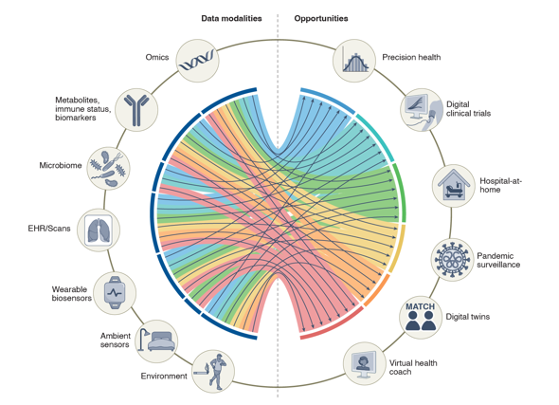
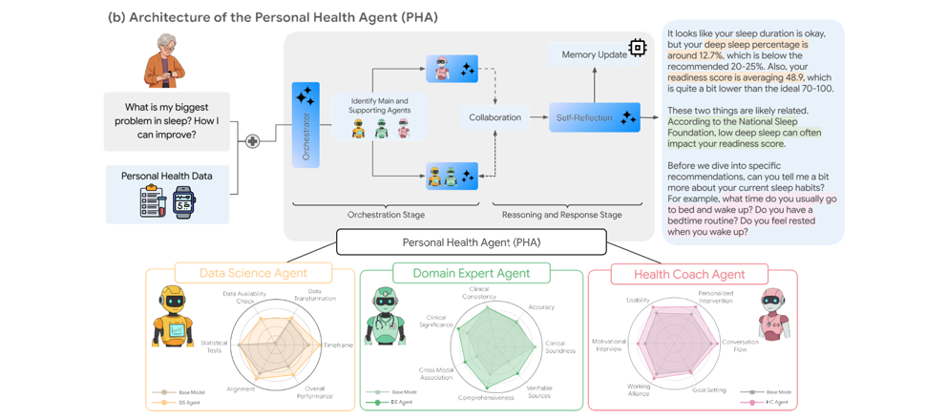
Aging | Digital Medicine and Multimodal Health
The Scripps Research Translational Institute (SRTI) has established large-scale digital research platforms integrating consumer wearable sensors, mobile multimodal phenotyping, and AI-based analytics.
Wearables enable continuous longitudinal measurement of physiologic parameters that change with aging, including heart rate dynamics, sleep architecture, physical activity, circadian regularity, and recovery following physiologic stress like age-related diseases.
SRTI-led digital trials have shown that wearable-derived signals can identify early physiologic perturbations preceding clinical disease, supporting their utility for detecting aging-related vulnerability, resilience, and transitions from health to disease.
These approaches support healthy aging research by enabling earlier identification of subclinical functional decline and informing timely interventions to preserve healthspan.

Slide 12
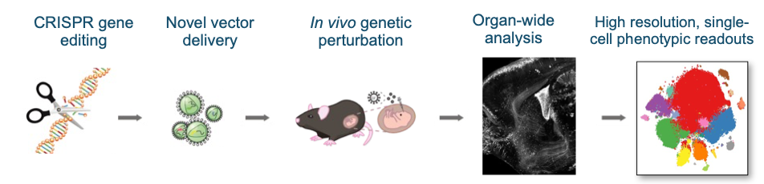
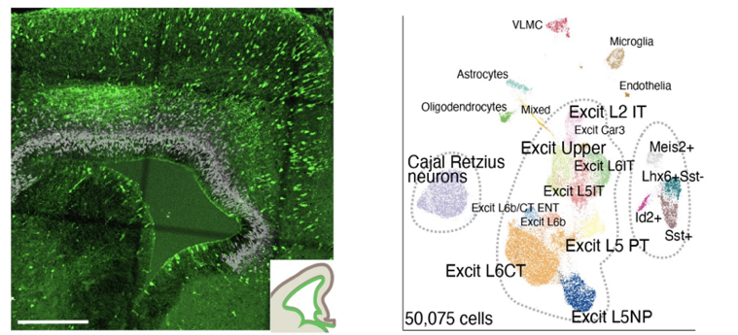
Aging | Massively Parallel Genetic Tools to Study the Aging Brain
High-control, high-throughput genetic screens:
a general path to disease functions
Background
The genetic and physiological factors that contribute to disease in the brain, including neurodegeneration, remain enigmatic despite growing numbers of identified disease associated gene variants
Current approaches are hampered by analyzing one gene variant at a time, evaluating complex cellular populations in bulk
Status
In vivo massively parallel Perturb-seq:
dissecting gene function in human disease and dysfunction
Scripps Research scientists have developed a method, called Perturb-seq, to virally deliver and study dozens of gene variants simultaneously in the adult mouse brain
This method enables the generation of tens of thousands of gene expression profiles in different cellular populations in the brain (neurons, astrocytes, glia, oligodendrocytes, etc.) in parallel to understand how gene variants affect different cell types and cellular communication as we age
48 hours after AVV injection
Analysis of > 30,000 cells in one equipment

Slide 13

Artificial Intelligence in Biomedical Research
areas of investment
Infrastructure
AI/ML engineering talent, high-performance computing, shared platforms that connect data across scientific disciplines
Research Projects
Targeted research projects that produce the training data next-generation models require and advance interdisciplinary, AI-facilitated research initiatives
AI is giving scientists the capacity to make sense of biological complexity at a scale that was previously unimaginable and is opening new directions in science.
Scripps Research is uniquely positioned to lead efforts to integrate AI into research
Scripps scientists generate some of the most precise, multimodal biological data in the world to train and interrogate by AI, across chemistry, structural biology, proteomics, immunology, and neuroscience
Our cross-disciplinary culture produces insights that siloed institutions cannot—and AI amplifies that advantage exponentially
With a seamless path from basic discovery to clinical application, Scripps can move from AI prediction to patient impact faster than any comparable institution
The institutions that build AI infrastructure and proprietary data assets now will define the field for the next generation and Scripps is investing now

Slide 14
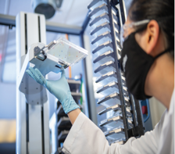
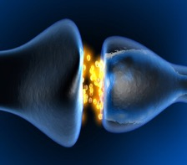
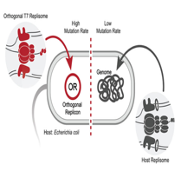

AI | Examples of Future Directions in AI Research
As infrastructure scales and the consortium grows, Scripps is positioned to extend AI-driven research across several additional high-impact domains.
Drug repurposing & discovery
AI integration with ReFRAME, the world's largest open-access drug repurposing library, to automate hit triage, predict pharmacokinetic properties, and build a domain-specific AI assistant for drug discovery.
Neuroscience & brain modeling​ ​
AI pipelines will integrate large-scale datasets (transcriptomics, epigenomics, proteomics, 3D electron microscopy of neural circuits) to build the unified multiscale models of the brain.
Digital medicine
Therapeutic protein design ​
The T7-ORACLE synthetic biology platform accelerates protein evolution 1,000-fold, generating deep datasets of evolutionary histories across therapeutically relevant protein classes—powerful training material for AI models predicting protein function.
SRTI's site-less clinical trials integrate genomics, wearables, biosensors, and generate richly layered data that AI models need to identify risk earlier, tailor prevention, and validate biomarkers at scale.

Slide 15
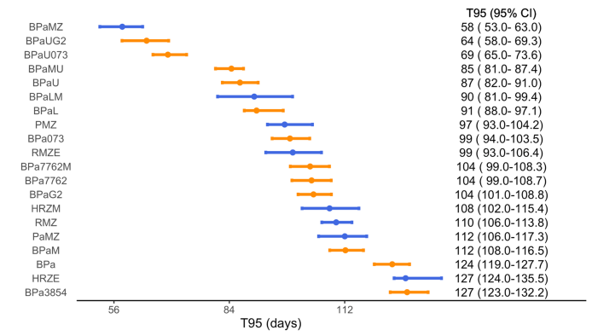


Impacting Global Health | Tuberculosis
Shortening tuberculosis (TB) treatment time to ≤ 3 months
Goal
CLB073 predicted to be exceptional partner to existing TB drugs BPaU: bedaquiline (B), pretomanid (Pa), & sutezolid (U)
TB continues to kill 1M+ people a year with one quarter of the world infected
Current TB treatment is 6-9 months, reducing adherence and increasing resistance
Rationale and Strategy
Identify a potentiator for a next-gen Nix-TB regimen as a pan-TB treatment with significantly shortened treatment (≤ 3 months) for all TB infections
Status
CLB073 modulates cholesterol catabolism, a key carbon source for intramacrophage Mtb, by activating adenylyl cyclase (Rv1625c) and causing high, intracellular accumulation of cAMP
CLB073 significantly enhances efficacy of the Nix-TB regimen at 5 mg/kg and achieves sterilization after 10 weeks of dosing in a preclinical model
Gates MRI is currently testing in a Phase 1 trial with good safety; long-acting formulation identified

Slide 16
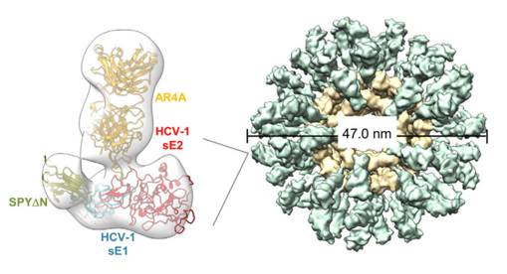
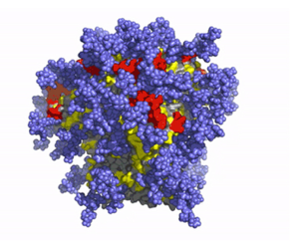
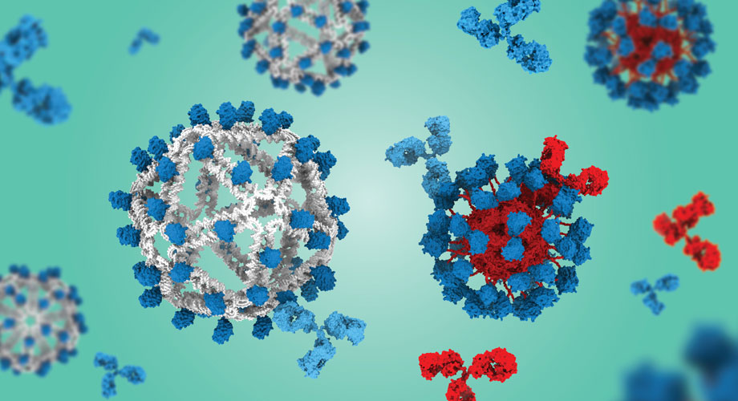
Global Health | Engineering the Next Generation of Vaccines
Many of the world's most dangerous viruses mutate rapidly, outpacing traditional vaccines. Scripps scientists are engineering a new class of vaccines designed to defeat even the most evasive pathogens.
Universal vaccines
Broadly neutralizing antibodies target the stable regions of a fast-evolving virus such as HIV and influenza that can't mutate without losing function, providing protection across a wide range of strains.
Engineering smarter vaccine designs
Using atomic-level structural biology to visualize how antibodies bind to viruses, Scripps scientists are engineering vaccine candidates that reliably trigger the right immune response—with promising results for HIV, influenza, and hepatitis C.
Next-generation delivery platforms
Self-assembling protein nanoparticles and DNA origami scaffolds present viral proteins in precise configurations that generate stronger, more targeted immune responses than conventional approaches.

Slide 17
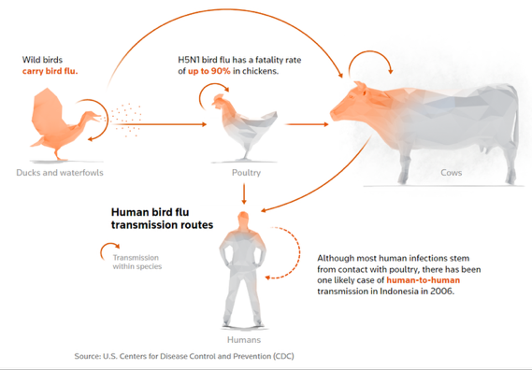
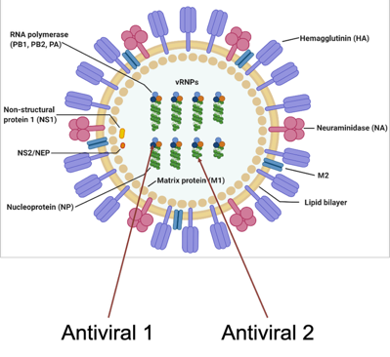
Global Health | Pandemic Preparedness
A substantial gap exists between what is required to
prepare for the next pandemic (H5N1) and what is being done.
Combination antivirals for influenza Targets different stages or mechanisms of the viral lifecycle needed to effectively mitigate an H5N1 or other pandemic viruses
First-in-class long-acting combination drugs for seasonal strains with pandemic potential (e.g., H5N1) to overcome resistance with improved efficacy for treatment and prophylaxis
Broad-spectrum viral polymerase inhibitor
Daily oral polymerase as a single drug and potential combination drug candidate
Identified novel nucleoside with excellent activity on flu, SARS-CoV-1/2, MERS, and HRV
Focused on flu and coronaviruses, but also active on other respiratory viruses including rhinovirus and RSV

Slide 18
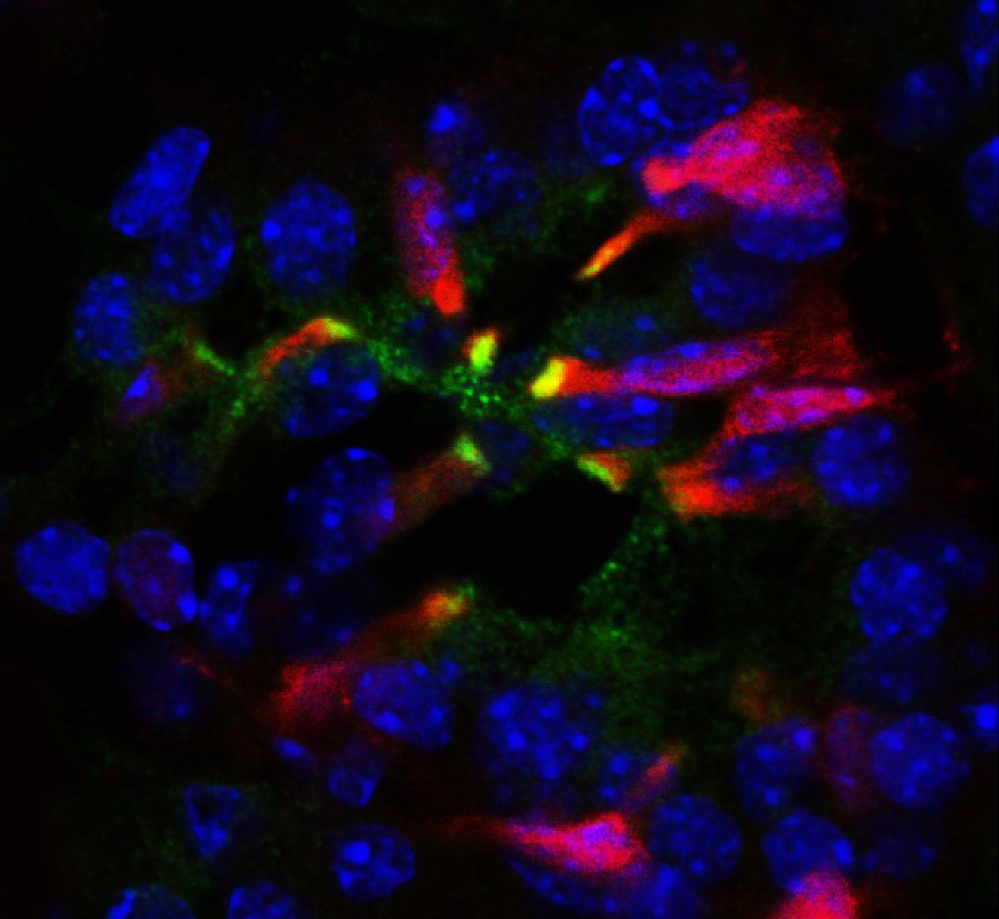
Facing an Uncertain Future

Slide 19
The Challenges Facing Nonprofit Research Institutes
Universities and research institutes have made the large majority of discoveries and technological advances that have enabled new medicines and the life sciences industry
Even with no decrease in IDC or NIH budget, federal funding does not support the total costs of operating a research institute, e.g., graduate program, new hires, full salaries, non-reimbursed operational (safety, utilities, etc.) and administrative activities, etc.
Many of our program face funding delays resulting from the confusion and changes at the NIH, leading to ongoing program terminations and layoffs of highly productive scientists
In addition, federal sources typically do not fund the high-risk, high-reward research that leads to transformational advances; NIH funding is also increasingly challenged due non-merit-based funding criteria
There is strong competition In research and drug development from China that threatens our leadership position in science and medicine
The result is that institutions, even those with large endowments and undergraduate tuitions, must rethink their “business model” and build a diversified funding portfolio to be sustainable

Slide 20
Broadening our impact on human health; building success-based sustainable research funding
Building a New, Nonprofit “Business- Model” That Bridges Basic and Translational Research: Calibr-Skaggs
Became a division of Scripps Research in 2018 as a one-of-a-kind translational research center in the nonprofit research world; autonomously funded throughout its history
Bridges the gap between basic and translational research to accelerate the development of innovative new medicines to impact human health (giving back to the public)
Addresses major unmet needs that are not pursued by large pharma due to commercial considerations and/or perceived risk
Funded by Foundations, Pharma and novel program-related investment vehicles (Gates/Abbvie)
Advanced 14 programs into clinical development across cancer, metabolic and cardiovascular disease, regenerative medicine, infectious and neurodegenerative disease; unprecedented nonprofit productivity
Generate sustainable revenues by moving medicines into clinical development (6-10% royalties and $300M+ milestone payments: >10 times historical revenues)
Owns and controls all intellectual property

Slide 21
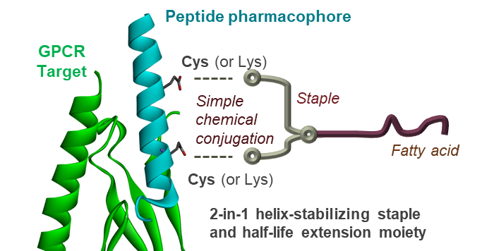

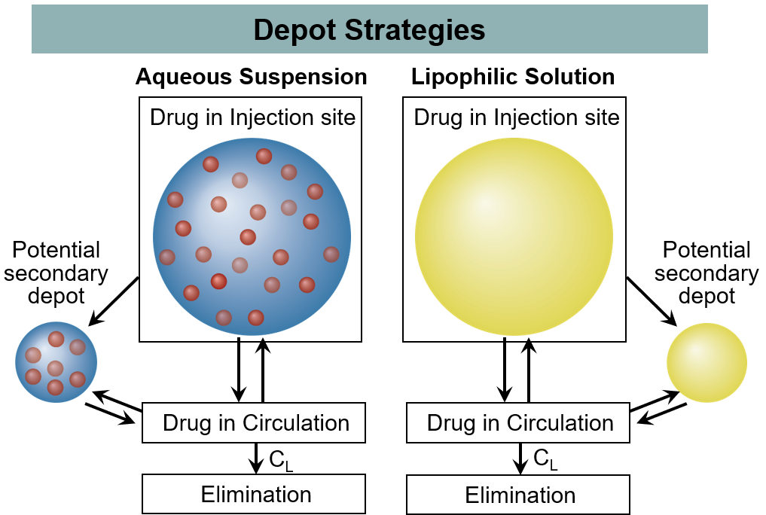
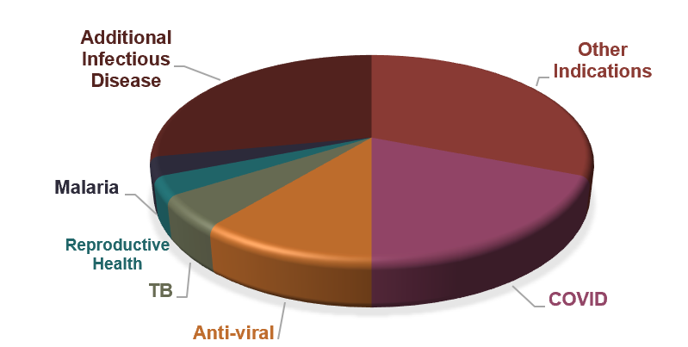
Calibr-Skaggs Technology Platforms Accelerate Discovery
Custom DEL Library Design
Bi- and Tri-specific Antibodies
Oral Peptides
Long-acting Injectables
Linear/Cyclic Peptides, Branched, & Linear
(Covalent and Non-covalent)
Oncology
Fatty Acid – Staple Strategies
Prodrug Strategies
DEL1
Her2
CD3
CDx
Approved antimalarial atovaquone
>100B Compounds
Her2
Costim
DLL3
CD3
DEL3
Costim
Improved PK and chemical stability
DEL2
Long-acting Formulation Strategies
Autoimmune
ReFRAME
Target X
Peptide Formulation Strategies
World’s Largest Public Repurposing Library
TL1A
PD1
Prodrug & SNAC
TNFα
avb7
TNFα
Intelligently designed DEL libraries enable range of programs, including opportunity for oral cytokine inhibitors (IL-23R, IL-4R, TL1A)
ReFRAME repurposes drugs for new indications, accelerating development
Calibr-Skaggs has developed a diverse multi-specific antibody program generating highly differentiated tri-specific antibodies for oncology and bi-specific antibodies for immunology
Calibr-Skaggs’ peptide stapling technology was used to develop CLF065 (GLP-2 with potential best-in-class half-life) and is being used in dual- and triple-agonist programs
Calibr-Skaggs’ long-acting injectable (LAI) platform underlies CLZ629 (GS-1614) licensed by Gilead and CBE161 carried forward by Medicines for Malaria Ventures

Slide 22
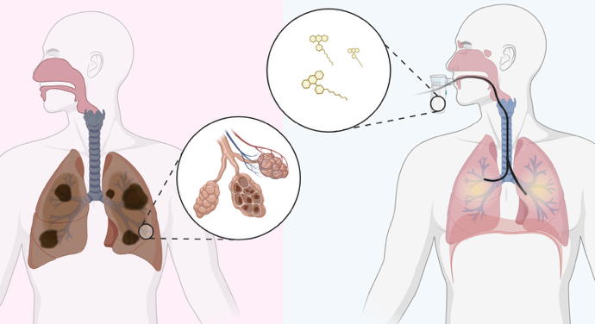
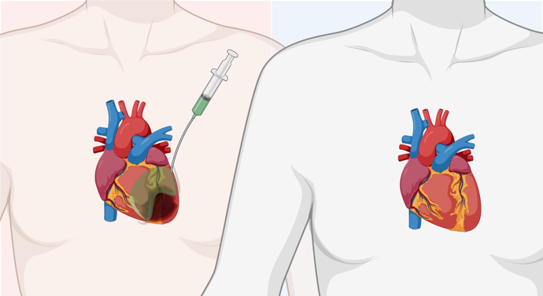
Heart and Lung Repair
Lung Regeneration
Heart Regeneration
Inhaled lung‑targeted drug to expand endogenous stem cells and repair damaged lung tissue in multiple diseases
Drug to repair the heart and improve cardiac function after damage due to heart attack and disease
Critical unmet need for lung therapies that can repair damage from disease (respiratory disease is the third leading cause of death)
A novel first-in-class drug engineered to expand lung stem (AEC2) cells
Inhaled QW delivery targets the lung directly, maximizing benefit while limiting effects elsewhere in the body
Currently completing a Phase 1 clinical trial for idiopathic pulmonary fibrosis (IPF), with potential to treat COPD and other chronic lung diseases
Heart failure is the number one killer globally, yet there are no approved treatments to repair heart damage
This novel approach is designed to repair damaged heart tissue after a myocardial infarction by reactivating developmental pathways
Restores heart function in pigs when given 3 days post-MI
Currently optimizing delivery method for Ph1 human trial

Slide 23
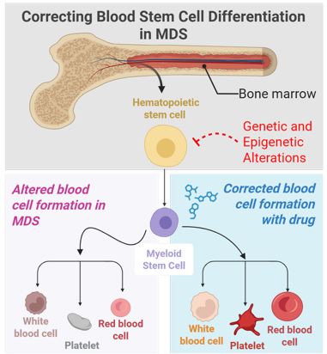
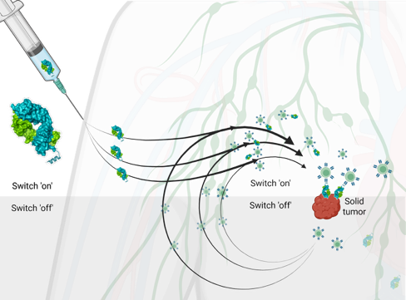
Cancer Treatment
Switchable CAR‑T (sCAR-T) Cell Immunotherapy
Myelodysplastic Syndromes (MDS)
A controllable chimeric antigen receptor T cell (CAR‑T) platform enabling safer, more precise cell therapies for cancer and autoimmune diseases
Oral drug to correct blood cell hematopoietic defects and avoid progression to acute myeloid leukemia (AML)
Addresses a major unmet need, as current treatments often provide limited benefit and many patients progress to acute leukemia
Targets the underlying biology driving hematopoietic dysfunction vs current less selective, toxic drugs by restoring hemaptopietic differentiation
In collaboration with MDA demonstrated activity in low and high-risk patient cells; initiating IND-enabling studies
CAR-T has been transformative for patients, but avoiding dangerous side effects and killing solid tumors remain a challenge
sCAR-T control helps physicians manage side effects and boost activity
Completed a Phase 1 clinical trial in blood cancers, demonstrated feasibility, safety and efficacy of this next‑generation CAR‑T approach
Has the potential to expand CAR‑T therapy to solid tumors and autoimmune diseases, where current CAR‑T treatments are limited

Slide 24


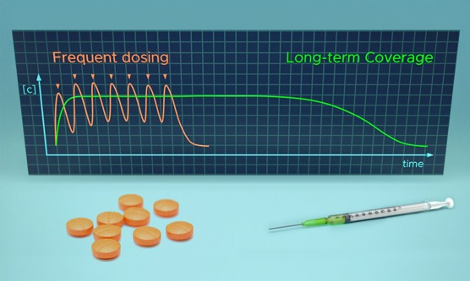
Preventing Infectious Disease
Malaria Prevention
Season-Long Protection from Malaria and Lyme Disease
Long-acting anti-parasitic preventative for malaria
Long-acting endectocide to malaria mosquitos and Lyme ticks
Malaria remains a major global unmet need, as it continues to cause more than 500,000 deaths each year
Atovaquone targets the malaria parasite directly using proven antimalarial biology with a strong safety foundation
As a long-acting injectable, Atovaquone was designed to reduce pill burden, improving adherence and decreasing resistance
MMV371 successfully completed a Phase 1 trial with malaria for Malaria Ventures, supporting advancement toward preventive use
Addresses major global health threats, including malaria and Lyme disease, which continue to cause significant illness worldwide
A long-acting injectable targets disease transmission by killing the vectors—malaria mosquitoes and Lyme‑carrying ticks—rather than treating infection after it occurs
Designed to provide season‑long protection
Leverages ivermectin’s well‑established safety in a novel delivery format to enable population‑level prevention strategies; beginning IND-enabling studies

Slide 25
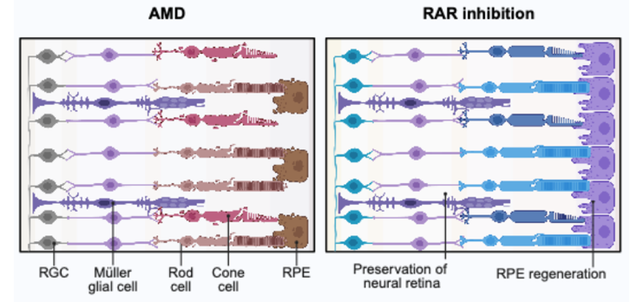
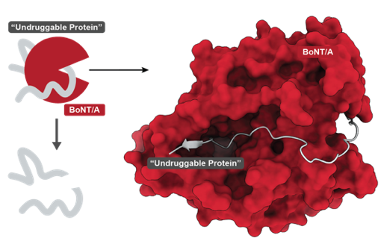
Age-related Macular Degeneration and Pain
Age-related Macular Degeneration (AMD)
A Nonaddictive Strategy for Chronic Pain
First‑in‑class, regenerative cell therapy to replace damaged retinal support cells and restore vision in age‑related macular degeneration
Evolved botox variant to silence pain signaling with long‑lasting, and targeted, non-addictive relief for people with chronic pain
Chronic pain affects millions of people and current treatments often provide inadequate relief or carry safety risks
A targeted biologic therapy designed to silence NaV1.7 and NaV1.8, key pain‑signaling pathways implicated in severe and chronic pain
Based on botulinum toxin’s (BoNT) established efficacy, half-life and safety, light chain protease engineered to block pain signals locally by cleaving Nav1.7/1.8 without affecting sensation broadly
Designed to provide pain relief for back and joint pain, diabetic neuropathy, inflammation, burns, etc.
AMD is a leading cause of vision loss and blindness in older adults
A regenerative epithelial cell therapy designed to replace and support damaged retinal cells that are essential for vision
Aims to restore retinal health and preserve vision, rather than only slowing disease progression
Delivered by intravitreal injection, enabling targeted treatment directly to the affected area of the eye- 2 years to FIH

Slide 26
Funding of New Medicines for Unmet Needs
There is a financial challenge to realizing the full potential of this work
High-risk, first-in-class medicines require clinical validation for pharma/biotech uptake (a catch 22)
Commercial case may not be not compelling for Pharma/Venture Investors despite the medical need
IND-enabling and early clinical trials are beyond Calibr-Skaggs ability to fund alone
Exploring new investment vehicles for interested parties to help advance much needed new medicines to patients while sharing in any financial returns from success
Scripps will reinvest its returns to expand its impact on science and medicine

Slide 27
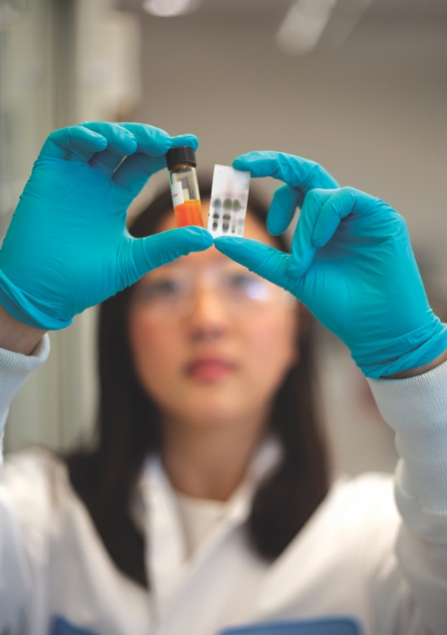
Philanthropy Remains a Critical Need: Endowed Chairs
Scientific Strength, Structural Disadvantage: Making the Case for Endowed Chairs
Scripps Research faculty are remarkably productive because they are free to focus primarily on research, but this results in a heavy reliance on external funding for their salaries, creating significant uncertainty in the current climate
An endowed chair is a permanent, donated fund that provides longer term committed support, using investment income to support salary and/or research programs.
Endowed chairs are the single most effective tool to:
Recruit junior and senior faculty, by offering partial salary stabilization (to reduce grant dependency)
Retain top talent
Sustain competitiveness across funding cycles
Enable agility in response to emerging scientific opportunities or funding challenges
Seed funding for high-risk, high-reward science

Slide 28

And Graduate Fellowships
Scripps Research’s graduate program is essential to training the next generation of scientific leaders, yet it remains partially dependent on external and federal funding sources that can limit flexibility and long-term stability.
Completing the endowed fellowship program is one of the most effective ways to
(shout out to the Skaggs Family who catalyzed the funding of the first 100 fellowships):
Recruit and retain the best and brightest minds from around the world in an increasingly competitive global landscape
Provide stable, 3-year continuous support that allows both faculty and students uninterrupted focus on studies, research and training
Empower students to pursue bold, high-impact science beyond federal funding constraints and reduce overall institution dependence on federal funding streams
Insulate the program from changes in national policy and uncertain funding environments

Slide 29

Our Vision for the Future of Scripps Research
Scripps is pioneering the development of a new vision for research institutes for others to follow which transcends conventional boundaries that constrain our impact on science, medicine, and public health and creates a sustainable success-based funding model for nonprofit research
Enabling Exceptional Scientists to Do Transformative Research
Accelerating the Impact of Scientific Discovery on Human Health
We will continue to hire the best faculty across the chemical and biological sciences and provide them cutting-edge tools and resources to advance our understanding of human biology. We will expand our top ranked graduate program and provide fellowships to all graduate students enabling them freedom to pursue the science that most excites them.
We will lead the development of new medicines and vaccines in the nonprofit world, including therapies that stop or reverse age-related disease and increase longevity, stop pain without risk of addiction, improve cancer survival, better prepare us for the next major viral pandemics, and provide low-cost solutions to prevent and treat the diseases that primarily afflict the poor around the world.

Slide 30


